Slide 1
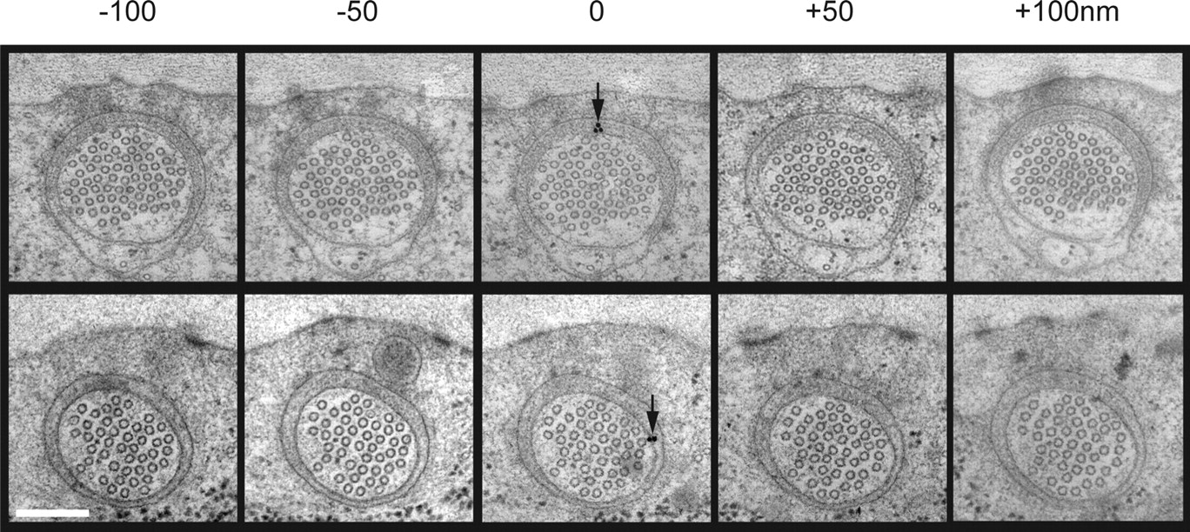

Sequential immunoelectron micrographs of 50 nm sections labeled with anti-MEC-2 (top) and anti-MEC-4 (bottom).
Cueva J G et al. J. Neurosci. 2007;27:14089-14098
©2007 by Society for Neuroscience
Notes:
Sequential immunoelectron micrographs of 50 nm sections labeled with anti-MEC-2 (top) and anti-MEC-4 (bottom). Scale bar, 200 nm.

